Slide 1

Project Proposal
Bengali Braille to Text Translation
Course: SE 801- Project
Date: 14-Aug-2016

Slide 2

Presented by
Minhas Kamal
Student of BSSE 8th Semester
Institute of Information Technology
University of Dhaka

Slide 3
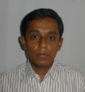
Supervised by
Dr. Mohammad Shoyaib
Associate Professor
Institute of Information Technology
University of Dhaka

Slide 4
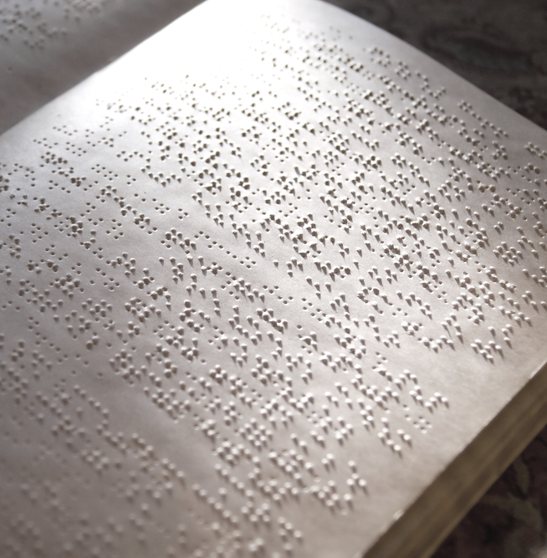
Contents
1/11
Motivation
Background
Objective
Methodology
Scope
Assumptions
Deliverables
Timescale
Resources

Slide 5


What is Braille?
2
Braille is a specialized writing system for visually impaired people, where raised dots on embossed paper are used as tactile alphabet.

Slide 6
Motivation
3
Help The Sightless
Digitally Interpret Analog Data

Slide 7
Background
4
Get every bit of information in digital form.
Very few researches have been performed over Bengali Braille to text translation.
No single open source tool available for this translation purpose.

Slide 8
Objective
5
Bengali Braille to Text Translator
Braille
Text

Slide 9
Methodology
6
1. Enhance Input Image
2. Detect Dots
3. Recognize Patterns
4. Map Patterns to Characters
5. Write Output to A Text File

Slide 10
Scope
7
1. Input image format- *.png or *.jpg
2. One-sided embossment
3. Character range- Bengali alphabets (অ-আ, ক-ঁ), their diacritic and abbreviated forms, numbers (০-৯), and common punctuation marks.
4. Output- a text file

Slide 11
Assumptions
8
Scanned image-
1. will not have any rotation or skew
2. background will be white
3. Random and Banding noise will be at minimum, and no Fixed Pattern noise will exist

Slide 12
Deliverables
9
A Software Installation File
User Manual
Source Code

Slide 13
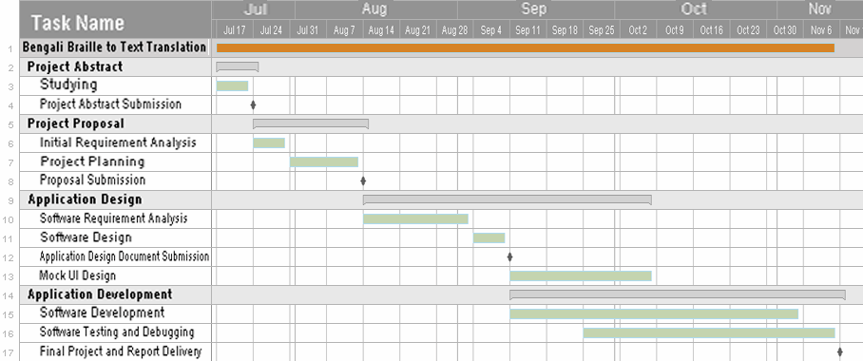
Timescale
10

Slide 14
Resources
11
Hardware Requirement-
A Personal Computer
A Scanner
Software Requirement-
Java Runtime Environment

Slide 15
THANKS

